Slide 1

Vehicle Characteristics and Their Impact on Resale Prices in the U.S.
By: Genesis Steliga Padilla
Course: BSAN 360
December 18th, 2025
https://github.com/genesissteliga-lgtm

Slide 2

How do vehicle characteristics (such as mileage, year, and engine size) affect the resale prices of different make origin/brand (Chevrolet, Chrysler, Ford, GMC, Jeep, and RAM) in both Used/New Cars in the USA?
Main Research Question:
Supporting Hypotheses:
Hypotheses’ 1. | Higher mileage decreases resale price.
Hypotheses' 2. | Newer model years increase resale price.
Hypotheses’ 3. | Age categories significantly influence pricing.
Hypotheses’ 4. | Adding brand, region, and car type improves model prediction accuracy.
For more info:
SLIDESGO | BLOG | FAQs
You can visit our sister projects:
FREEPIK | FLATICON | STORYSET | WEPIK | VIDEVO

Slide 3
Dataset
Description
01
03
02
04
Dataset Source:
Kaggle — U.S. Used Car Listings Dataset (2025)
https://www.kaggle.com/datasets/akshatsharma2407/cars-dataset
Sample Size: 216,517 vehicles after cleaning and preprocessing
Key Variables: Mileage, Model Year, Age of Car + Age Category, Brand (Ford, Chevrolet, GMC, Jeep, RAM, etc.), Car Type (SUV, Truck, Hybrid, Electric, Coupe, etc.), Region (Midwest, West, Northeast, South), Price (K$)
Data Cleaning Steps: Removed duplicates and rows with missing essential values, Standardized formatting for mileage, year, and price, Filtered out extreme/unrealistic data points Combined and simplified car types and regional categories
Transformations: Removed image columns
Created dummy variables (brand, region, car type), Applied Box-Cox transformation to normalize price distribution Converted mileage and year into useful predictors (age categories, simplified types)

Slide 4
Model 1: Numeric Regression
Model: PRICE(K$) ~ Mileage + Model Year + Age of Car + Rating
Interpretation: Model 1 used only numeric features and explained about 13% of price variation, capturing only part of the story. Mileage lowered price, while newer model years and higher ratings increased it, and some older cars sold for more due to collectability. While these basic characteristics matter, the low explanatory power shows that important market factors are missing, motivating the expanded Model 2
Equation:
Resale Price = 0.000051512 -0.0004(Mileage) + 0.0239(Model_year) + 0.0876(Age of car) + 1.6848(Rating)
Results:
Mileage: Strong negative effect on price
Model Year: Positive and highly significant
Age: Negative effect independent of mileage
R-squared: 0.131

Slide 5
Model 2: Full Regression
Variables Added:
Brand, region, car type, stock type, make origin
Equation key Findings:
Resale Price = f(mileage, model year, age, rating, make, car type, region, condition, origin)
the make is significant
Interpretation: Model 2 added brand, car type, condition, region, and origin, increasing the adjusted R² to 0.633 and representing a substantial improvement over Model 1. Luxury and hybrid/electric vehicles were associated with higher resale prices, while economy brands tended to lower prices, and certified cars consistently sold for more. Although mileage and model year remained important, brand and category effects dominated price prediction, indicating that resale value depends more on market segment and positioning than on numeric vehicle features alone.
Results:
Adjusted R² increases to 0.633 (large improvement over Model 1)
Make is statistically significant, with the largest positive price effects coming from luxury brands such as Ferrari, Lamborghini, and Bugatti
Car type (SUV, electric, hybrid, truck) significantly affects resale price
Certified vehicles sell for more than standard used cars
Region shows noticeable price differences across markets

Slide 6
ANOVA Model Comparison
Purpose:
Test whether Model 2 improves significantly over Model 1.
Results:
F-statistic extremely high
p-value = 0.00
NaN in first row is normal for baseline comparison
Conclusion:
Model 2 is statistically superior based on ANOVA results (p < 0.001), indicating that adding brand, car type, and region significantly improves the model’s ability to explain resale prices. This confirms that market and categorical factors provide meaningful information beyond basic vehicle characteristics.

Slide 7
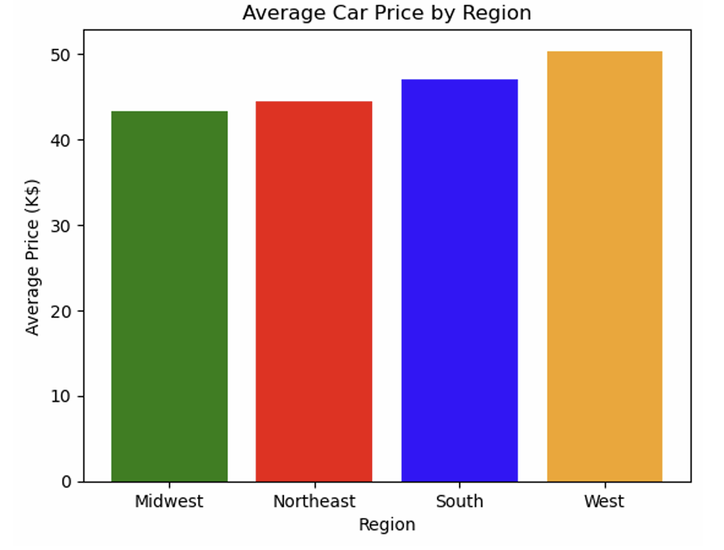
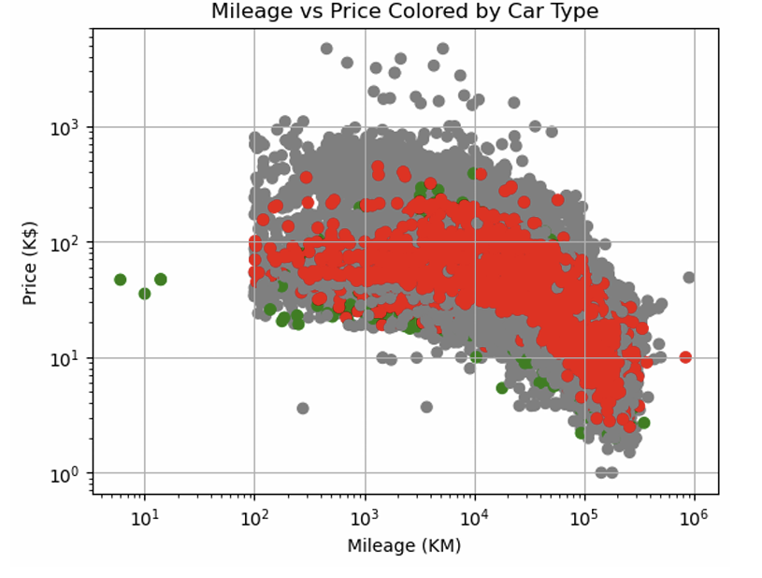
Data Visualization (Part 1)
Average Price by Region:
Highest prices: West
Lowest prices: Midwest
Regional pricing differences reflect demand, cost of living, and vehicle mix.
Mileage vs. Price Scatterplot:
Clear negative relationship
Clustering seen by car type
Higher-end vehicle types retain value better at similar mileage levels.

Slide 8
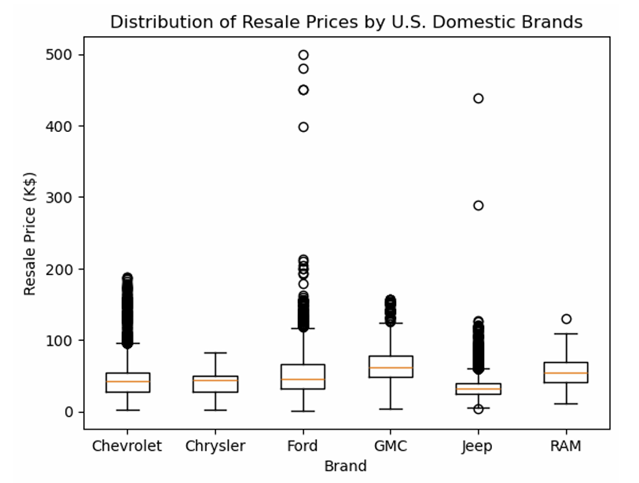
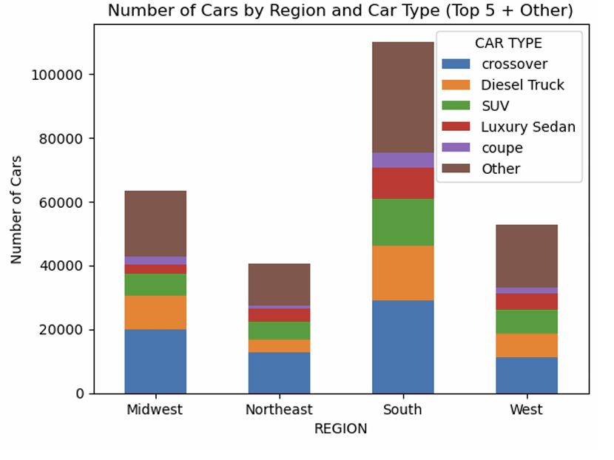
Data Visualization (Part 2)
Boxplot: Resale Prices by Brand:
    Prices vary widely across brands, with luxury brands showing the highest medians.
    Confirms that brand significantly influences resale price (supports Model 2).
Stacked Bar Chart Cars by Region & Type:
The South has the highest overall car volume.
Crossovers, SUVs, and diesel trucks dominate all regions.
Regions differ in variety of niche car types (seen in the “Other” category).
**These visuals summarize trends captured in pivot tables, highlighting how brand, region, and car type shape market patterns.

Slide 9
Pivot Table Summary
Pivot Table Insights:
1. Showed how car types and prices differ across regions.
2. Revealed that older cars cluster into higher-mileage categories.
3. Identified which brands hold stronger resale value.
4. Dealer-state counts highlighted where most used cars are listed.
Overall, the tables guided my visualizations and supported trends later confirmed by regression and ANOVA.

Slide 10
Final Conclusions:
1. Model 1 (numeric features only) explained 13% of price variation.
2. Model 2 (adding brand, region, origin, stock type, car type) improved to Adjusted R² = 0.633.
3. ANOVA confirmed Model 2 is significantly better (p = 0.0).
Brand, origin, and car type influence resale value more than mileage or age alone.
4. Pivot tables + visualizations showed consistent patterns across regions, brands, and vehicle categories.
5. Overall, resale price depends on both car condition and market identity.

Slide 11
Additional Notes:
Pivot tables and visualizations support the regression results:
Regional averages align with model estimates
Brand price boxplots mirror Model 2’s coefficients
Mileage vs price visualization confirms expected depreciation trend
Price category pivot tables explain luxury vs non-luxury pricing gaps
Together, these strengthen the conclusion that vehicle characteristics are the key drivers of resale values.

Slide 12

Thank You
Do you have any questions?
genesissteliga@gmail.com
Please keep this slide for attribution

